Slide 1


Security That Enables: Breaking Down Security Silos in the DevOps Ecosystem
Saurabh Wadhwa
Sr. Solutions Engineer

Slide 2

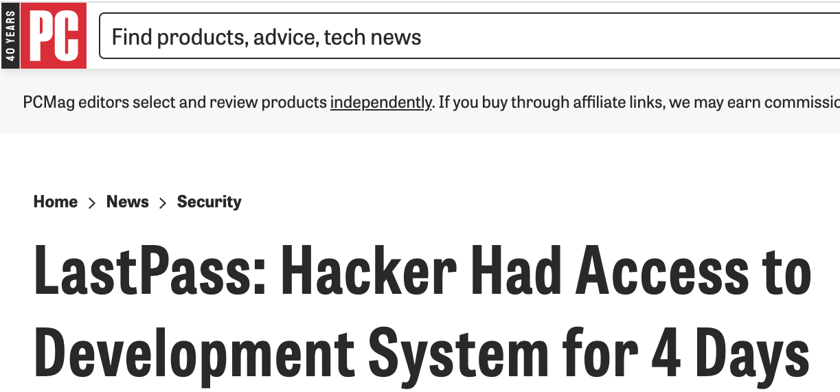
Agenda
Introduction
1
Rise in attacks on CI/CD ecosystem
2
Security gaps in traditional pipeline
3
Breakdown of Dropbox breach
4
Enabling Dev and Security Teams
5

Slide 3
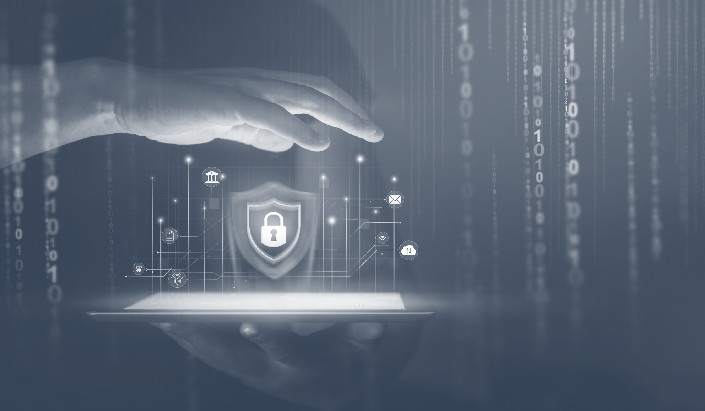
Rise in Attacks on CI/CD Ecosystem

Slide 4
Key Challenges in the Dev Ecosystem
Lack of integrated and automated security testing tools
Large and fragmented attack surface
Diverse and complicated technical stack
Reliance on automation leads to complacency

Slide 5
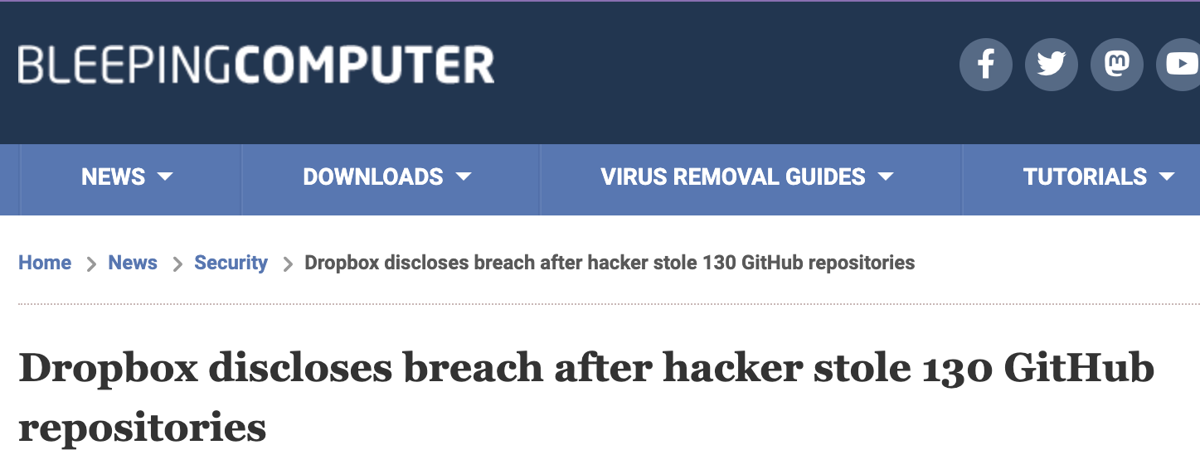

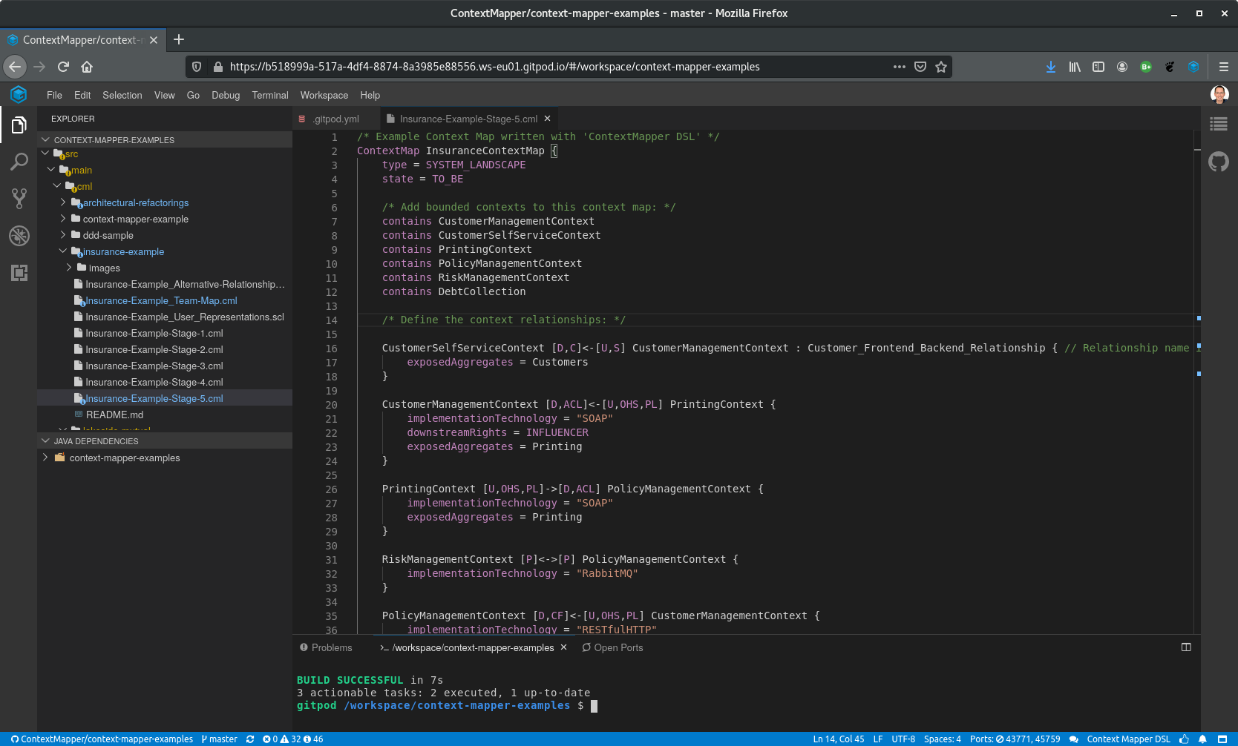

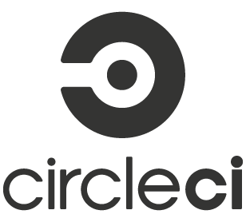
Dev Laptop to Cloud Breaches
Public keys stolen
Employee GitHub tokens stolen
Authenticated session keys stolen

Slide 6
Security Gaps in
CI/CD Pipeline

Slide 7

Why Security Gaps Persist in the CI/CD Ecosystem
Unrealized potential for CI/CD adoption
System hinges on various dependencies and configurations
Haste and need for fast-paced delivery cycles

Slide 8
















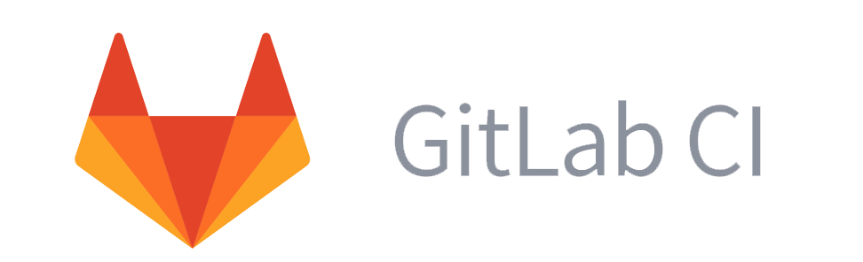


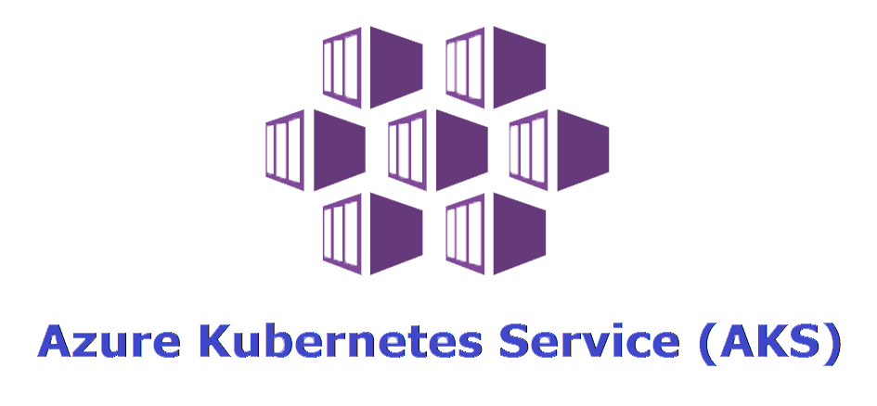


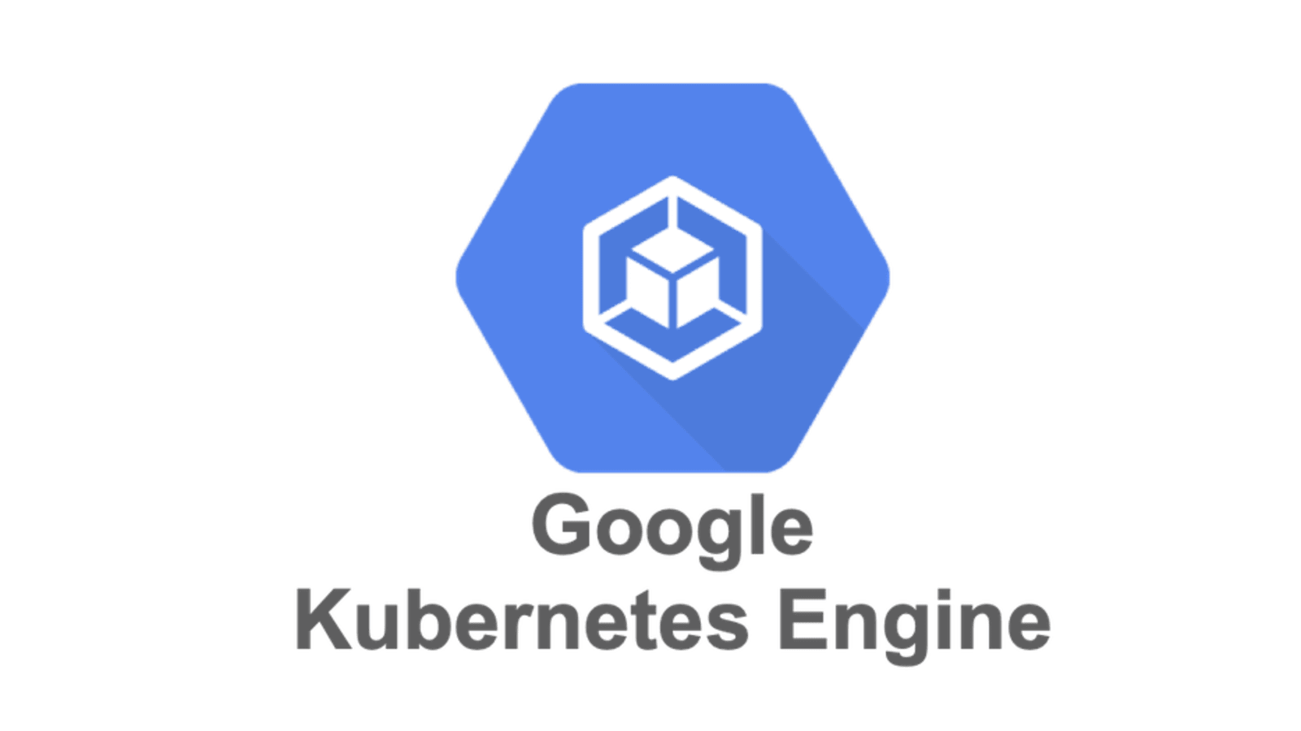


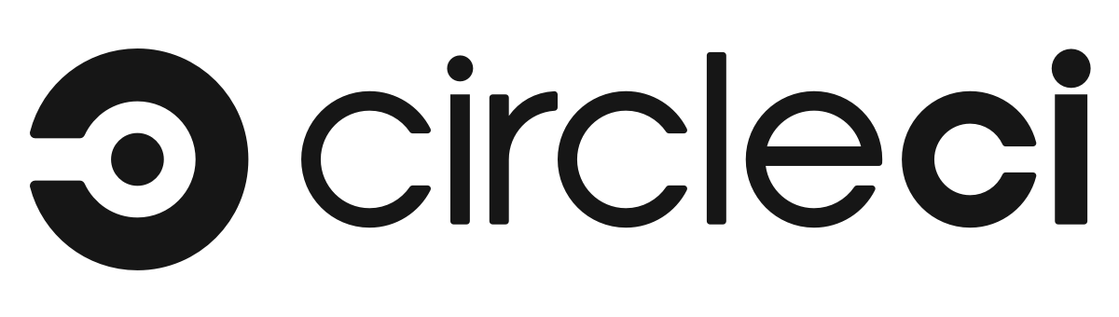


Securing Your CI/CD Pipeline
Development
CI/CD
Control Plane
Data Plane
Code Development
Node 1
Developer
Laptop
Build and Test
Container
Orchestration
Registry Scanning
Container
Runtime
Node 2
CI / CD Tool
Registry
Code Pull
Git Repository
Node 3
Pre-production
Post-production

Slide 9

Securing Your CI/CD Pipeline in Runtime
Control Plane
Data Plane
Isolated Control and Data Planes
Node 1
Container
Orchestration
Container
Runtime
Node 2
Tracking Attacker Movements (e.g. Container Escape)
Node 3

Slide 10
Securing Your CI/CD Pipeline in Pre-Production
Development
CI/CD
Isolated Developer Tools
Code Development
Developer
Laptop
Build and Test
Registry Scanning
Security from Laptop to Cloud
CI / CD Tool
Registry
Code Pull
Git Repository

Slide 11
Anatomy of the Dropbox Breach

Slide 12

Dropbox: Breakdown of Events
Overview
Disclosed
Breach
Techniques used
1
2
3
4
Sophisticated, targeted attack on CI/CD ecosystem
November 1st, 2022 publicly disclosed
130 internal repos cloned
Public and private code in the stolen repos
Phishing emails, enumeration (secrets, shared keys, data), impersonation

Slide 13
Attack Path: Dropbox
Dropbox attack through phishing campaign
Code
Attacker
Phishing Email
Imitation Login
Page
Victim’s GitHub
Account
Secrets
Attacker imitates CircleCI email
Attacker imitates CircleCI login to obtain credentials and hardware key
Victim’s
Credentials and
Hardware key
Data
Developers receive email imitating CircleCI
Developers click on email, are directed to imitation CircleCI webpage
Developers asked to enter their GitHub account credentials.
1
2
3
Developers use their hardware authentication key to enter a One-Time Password (OTP)
Attackers take OTP and access Dropbox GitHub account
Outcome: 130 internal repositories cloned, both public and private code repos.
4
5
6
Source: https://blog.gitguardian.com/dropbox-breach-hack-github-circleci/

Slide 14

Lessons Learned from Dropbox Breach
Reinforces an alarming trend of attackers targeting developer tools as an entry point
Regularly rotate passwords and set up MFA on your accounts
Attackers are sophisticated and familiar with environments
Scan source code repositories for credentials stored in plain text (API keys, passwords, etc.)

Slide 15
Enabling Dev and Security Teams

Slide 16
Good and Bad Security Cultures
Good Security Culture:
Bad Security Culture:
Builds trust
Simplifies access and workflows
Encourages people to speak up
User driven sec
Erodes trust
Complicates access and workflows
Encourages users to hide their mistakes

Slide 17


Security Solutions that Enable
Zero Trust Frameworks
Always validate a users integrity when accessing internal resources. Reduces friction for ‘good’ users and create friction for ‘malicious’ users.
Build-Time and Registry Scanning
Scan for vulnerabilities, private keys, credentials, and other secrets stored in images or registry code.

Slide 18
Solutions in Action
Zero-Trust
Build-Time and Registry Scanning
Builds trust
Simplifies access and workflows
Reduces ability for lateral movement
Empowers modern developer work culture [work from home, shifted hours, dynamic location changes, etc]
Reduces attack surface
Simplifies workflows
Enables teams to release builds
Hardens static code and container image repos

Slide 19
Conclusion
Developers and our ecosystems are being targeted
Good security enables developers to work dynamically and ship faster/more secure
Dev and security teams should work together to highlight gaps in the CI/CD pipeline
A good security program should not hamper innovation.

Slide 20
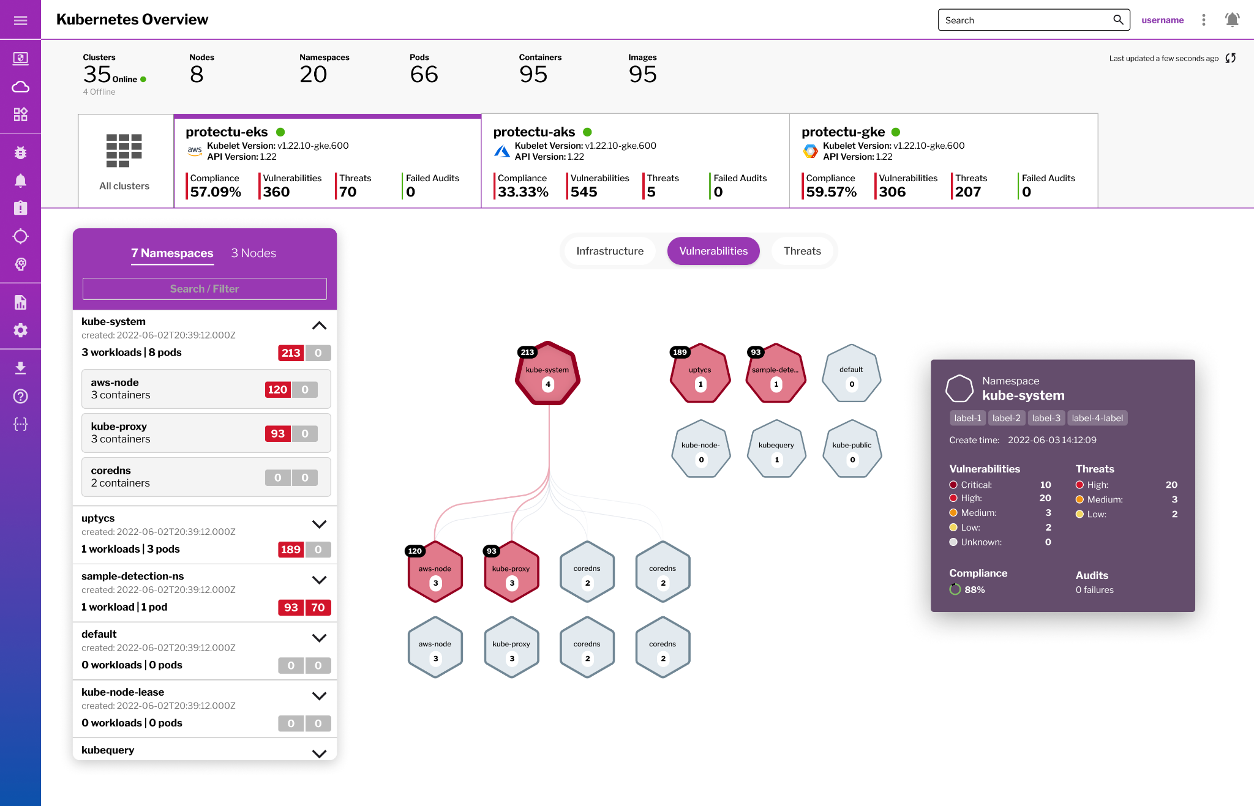
Thank You!
Open Q&A

